Slide 1
Web Services

Slide 2
What is Web Service
They are distributed computing technology (like CORBA, RMI, EJB, etc.). They allow us to create client/server applications.
Web services are open standard ( XML, SOAP, HTTP etc.) based Web applications that interact with other web applications for the purpose of exchanging data

Slide 3
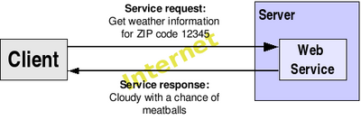
Web Services
For example, let's suppose I keep a database with up-to-date information about weather in the United States, and I want to distribute that information to anyone in the world. To do so, I could publish the weather information through a Web Service that, given a ZIP code, will provide the weather information for that ZIP code.

Slide 4
Components of Web Services
SOAP (Simple Object Access Protocol)
UDDI (Universal Description, Discovery and Integration)
WSDL (Web Services Description Language)

Slide 5
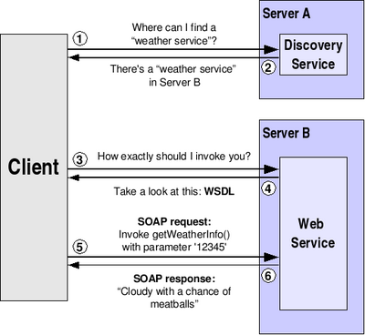
Web Services Architecture

Slide 6
Web Services Architecture Cont..
* Service provider:
This is the provider of the web service. The service provider implements the service and makes it available on the Internet.
* Service requestor:
This is any consumer of the web service. The requestor utilizes an existing web service by opening a network connection and sending an XML request.
* Service registry:
This is a logically centralized directory of services. The registry provides a central place where developers can publish new services or find existing ones.

Slide 7
Web Service Protocol
Service transport:
This layer is responsible for transporting messages between applications. Currently, this layer includes hypertext transfer protocol (HTTP), Simple Mail Transfer Protocol (SMTP) and file transfer protocol (FTP).
XML messaging:
This layer is responsible for encoding messages in a common XML format so that messages can be understood at either end. Currently, this layer includes SOAP.

Slide 8
Web Service Protocol Cont....
Service description
This layer is responsible for describing the public interface to a specific web service. Currently, service description is handled via the Web Service Description Language (WSDL).
Service discovery
This layer is responsible for centralizing services into a common registry, and providing easy publish/find functionality. Currently, service discovery is handled via Universal Description, Discovery, and Integration (UDDI).

Slide 9
Web Services Components

Slide 10
What is SOAP?
SOAP is an XML-based protocol to let applications exchange information over HTTP.
* SOAP stands for Simple Object Access Protocol
* SOAP is a communication protocol
* SOAP is a format for sending messages
* SOAP is designed to communicate via Internet
* SOAP is platform independent
* SOAP is language independent
* SOAP is based on XML
* SOAP is a W3C standard

Slide 11
What is WSDL?
* WSDL stands for Web Services Description Language
* WSDL is based on XML
* WSDL is used to describe Web services
* WSDL is used to locate Web services
* WSDL is a W3C standard

Slide 12
What is UDDI?
# UDDI stands for Universal Description, Discovery and Integration
# UDDI is a directory for storing information about web services
# UDDI is a directory of web service interfaces described by WSDL
# UDDI communicates via SOAP

Slide 13
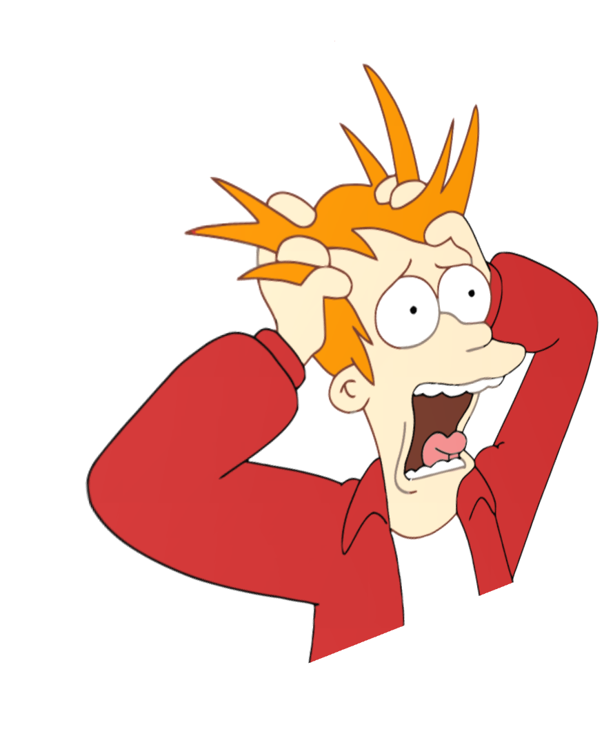







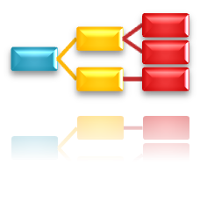




Questions?

